Slide 1
“ The Period of Existence ”

Slide 2
Group No. 04
INSIGHT
ANALYTICS
Roshan Sharma (02)
Ashishkumar Rana (09)
Jaisingh Chauhan (17)
Sayali Kokitkar (20)
Akshada Satpute (51)

Slide 3
Data Description
Data
Life Expectancy (WHO)
Sample Size
2938
Dependent Variable
Life Expectancy
Independent Variables
Infant deaths, Diphtheria, GDP, etc.

Slide 4
Objective
To study how immunization, economic factors, social factors and other health-related factors will affect the life expectancy rate.
To study which variables may affect Life Expectancy (year 2000 to 2015).
To study which variables may affect Life Expectancy during years from 2000 to 2007 and 2008 to 2015
Notes:
Isme na ye green wala part hata de
!

Slide 5
Methodology
Entire Data (2000 to 2015)
Factor Analysis + Regression Analysis

Slide 6
Methodology
Entire Data (2000 to 2015)
Regression Analysis

Slide 7
Methodology
Data (2000 to 2007)
Data (2008 to 2015)
Regression Analysis
Regression Analysis

Slide 8
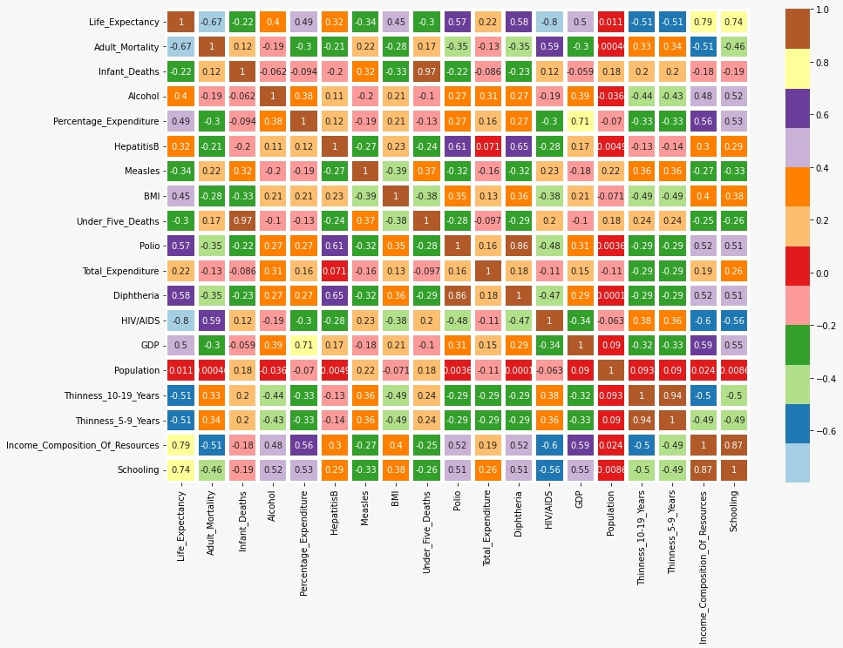

Slide 9
Multicollinearity
Features | VIF (Before)
Adult Mortality | 5.79
Infant Deaths | 38.70
Alcohol | 3.86
Percentage Expenditure | 3.50
Hepatitis B | 64.35
Measles | 2.00
BMI | 42.52
Under Five Deaths | 37.30
Polio | 127.90
Total Expenditure | 8.80
Diphtheria | 142.73
HIV/AIDS | 3.08
GDP | 4.47
Population | 2.01
Thinness 10 to 19 Years | 22.43
Thinness 5 to 9 Years | 22.04
Income composition of Resources | 78.55
Schooling | 77.42

Slide 10
Factor Analysis +Regression Analysis
on Entire Dataset (2000 to 2015)

Slide 11
Factor Analysis
Assumptions
No Outlier
Adequate Sample Size
No perfect Multicollinearity
Homoscedasticity
Linearity

Slide 12





Factor Analysis
Correlation Matrix
Adequacy Test
Factor Extraction
Factor Scores
Rotation
Step 1
Step 2
Step 3
Step 4
Step 5

Slide 13
Bartlett’s Test of Sphericity
Hypothesis
H_{o}: The correlation matrix is an identity matrix.
V/S
H₁: The correlation matrix is not an identity matrix.
p-value = 0.0
Therefore, We reject Null Hypothesis.

Slide 14
Kaiser–Meyer–Olkin (KMO) Test
KMO Values | Interpretation
0.00 to 0.49 | Unacceptable
0.50 to 0.59. | Miserable
0.60 to 0.69 | Mediocre
0.70 to 0.79 | Middling
0.80 to 0.89 | Meritorious
0.90 to 1.00 | Marvellous
KMO Value: 0.82778

Slide 15
Eigen Value Criteria
6.4369 | 2.0989 | 1.7594
1.2117 | 1.1160 | 0.9199
0.8426 | 0.6569 | 0.6069
0.5559 | 0.4489 | 0.3958
0.3429 | 0.2663 | 0.1408
0.1150 | 0.0571 | 0.0281

Slide 16
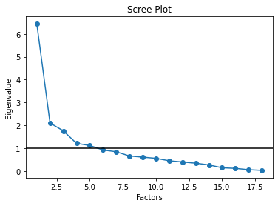
Scree Plot

Slide 17
 | Immunization | Thinness | Economic & Social | Children | Mortality
Adult Mortality | -0.254644 | 0.238319 | -0.305836 | 0.073714 | 0.457733
Infant Deaths | -0.094169 | 0.088410 | -0.028491 | 0.946985 | -0.005980
Alcohol | 0.152826 | -0.375621 | 0.448054 | -0.001783 | 0.134535
Percentage Expenditure | 0.099244 | -0.176480 | 0.748710 | -0.055636 | 0.057925
HepatitisB | 0.674920 | -0.028016 | 0.054422 | -0.137815 | -0.008594
Measles | -0.263179 | 0.329183 | -0.105952 | 0.311176 | -0.014152
BMI | 0.259603 | -0.427738 | 0.121219 | -0.294523 | -0.167334
Under Five Deaths | -0.148590 | 0.110838 | -0.073838 | 0.978530 | 0.035872
Polio | 0.853873 | -0.139161 | 0.205531 | -0.121632 | -0.069914
Total Expenditure | 0.110690 | -0.288584 | 0.156793 | -0.043903 | 0.111050
Diphtheria | 0.906656 | -0.141376 | 0.185668 | -0.123569 | -0.050438
HIV/AIDS | -0.369461 | 0.246347 | -0.314474 | 0.069595 | 0.671839
GDP | 0.145006 | -0.152799 | 0.769320 | -0.005971 | 0.014109
Population | 0.016421 | 0.126469 | 0.046100 | 0.197416 | -0.132788
Thinness 10 to 19 Years | -0.117352 | 0.925140 | -0.195204 | 0.096103 | 0.052544
Thinness 05 to 09 Years | -0.116353 | 0.919815 | -0.195733 | 0.101379 | 0.038880
Income Composition of Resources | 0.352525 | -0.324189 | 0.690682 | -0.102796 | -0.293615
Schooling | 0.357281 | -0.349612 | 0.657048 | -0.118398 | -0.203354
Rotation(Equamax)

Slide 18
Factor Extraction
Immunization | Thinness | Economic & Social | Children | Mortality
Hepatitis B | Measles | Alcohol | Infant Deaths | Adult Mortality
BMI | Thinness 10 to 19 Years | Percentage Expenditure | Under Five Deaths | HIV/AIDS
Polio | Thinness 5 to 9 Years | Total expenditure | Population
Diphtheria |  | GDP
 |  | Income Composition of Resources
 |  | Schooling

Slide 19
Regression
Assumptions
Linear Relationship
Correlation
Multicollinearity
No auto-correlation
Homoscedasticity

Slide 20
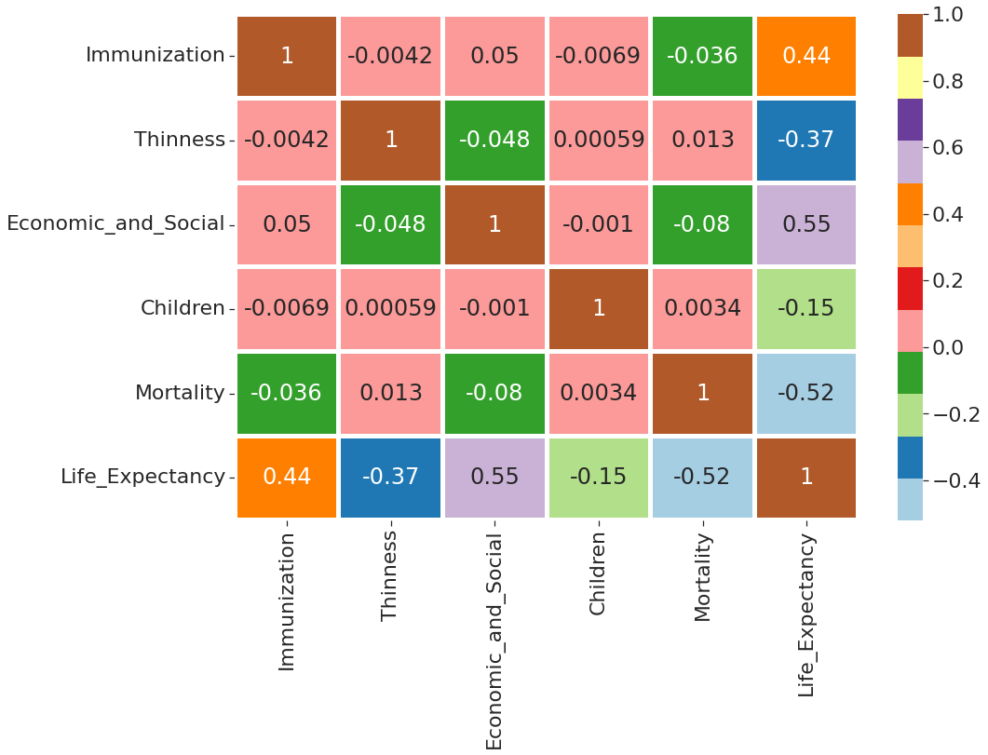
Correlation

Slide 21
Impact on Life Expectancy
Train: 80% Test: 20%
Life Expectancy = 69.2394+ 3.7727 (Immunization) - 3.1969 (Thinness) + 4.4872 (Economic & Social) -1.3562 (Children) -4.3677(Mortality)
Factors | Impact on Response Variable
Immunization | 21.96%
Thinness | -18.60%
Economic & Social | 26.11%
Children | -7.90%
Mortality | -25.42%

Slide 22
Checking Normality
Mean of Residuals = -4.538402750535789e-15
The mean of the residuals is so small that we can consider it zero.

Slide 23
Checking Heteroscedasticity
Goldfeld Quandt Test
Hypothesis
H_{o}: Error terms are homoscedastic
V/s
H₁: Error terms are heteroscedastic.
F Statistic : 1.0849 p-value : 0.08175
Therefore, We do not reject the Null hypothesis.

Slide 24
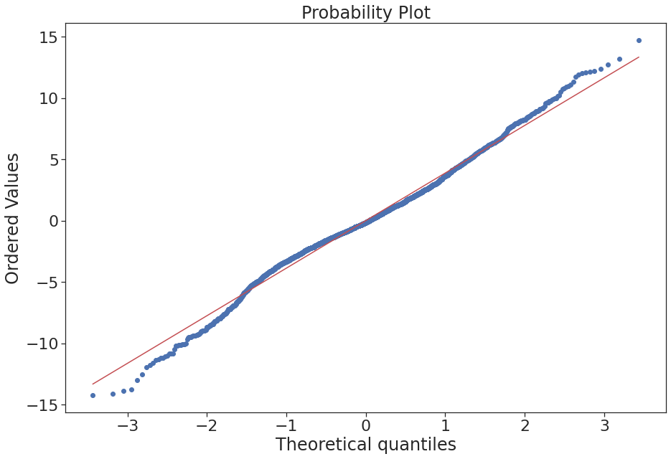
Q-Q Plot

Slide 25
Ljung-Box Test
Hypothesis
H_{o}: Autocorrelation is absent.
v/s
H₁: Autocorrelation is present..
p-value = 0.3195
Therefore, We do not reject Null Hypothesis.

Slide 26
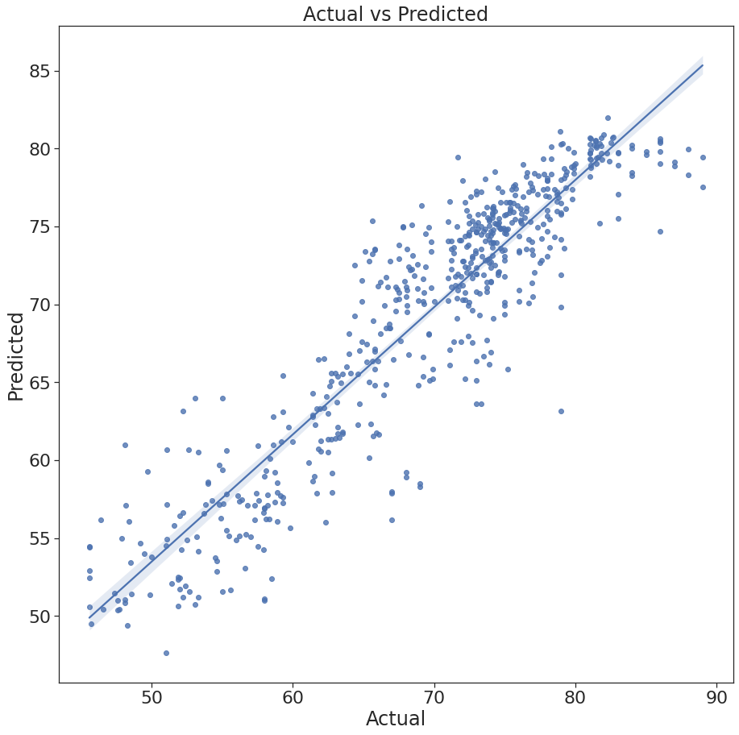
Linearity

Slide 27
Model Evaluation
R – squared : 84.33%
Adj. R – squared : 83.18%
Accuracy | Values
Mean Absolute Error | 2.8589
Mean Square Error | 14.4446
Root Mean Square Error | 3.8006
Mean Absolute Percentage Error | 4.30%

Slide 28
Regression Analysis on Entire Dataset (2000 to 2015)

Slide 29
Multicollinearity
Features | VIF (Before)
Adult Mortality | 5.79
Infant Deaths | 38.70
Alcohol | 3.86
Percentage Expenditure | 3.50
Hepatitis B | 64.35
Measles | 2.00
BMI | 42.52
Under Five Deaths | 37.30
Polio | 127.90
Total Expenditure | 8.80
Diphtheria | 142.73
HIV/AIDS | 3.08
GDP | 4.47
Population | 2.01
Thinness 10 to 19 Years | 22.43
Thinness 5 to 9 Years | 22.04
Income composition of Resources | 78.55
Schooling | 77.42

Slide 30
Multicollinearity
Features | VIF (After)
Alcohol | 2.58
Percentage Expenditure | 3.30
Measles | 1.85
HIV/AIDS | 2.56
GDP | 4.11
Population | 1.91
Children | 5.41
Thinness | 3.09

Slide 31
Data Preparation for Model Building
Train: 80% Test: 20%
Life Expectancy = 69.24249757584911+1.12250267(Alcohol)+0.99761121(Percentage Expenditure)-0.31949317(Measles)-4.93548287(HIV/AIDS)+ 0.83183958(GDP)+0.18006342(Population)-2.3797(Children)-0.94994484(Thinness)
Features | Impact on Response Variable
Alcohol | 9.58%
Percentage Expenditure | 8.51%
Measles | -2.73%
HIV/AIDS | -42.12%
GDP | 7.09%
Population | 1.53%
Children | -20.31%
Thinness | -8.10%

Slide 32
Model Evaluation
R – squared : 80.18%
Adj. R – squared : 79.57%
Accuracy | Values
Mean Absolute Error | 3.2876
Mean Square Error | 18.2575
Root Mean Square Error | 4.2728
Mean Absolute Percentage | 4.97%

Slide 33
Regression Analysis on Both Dataset i.e.,
Dataset (2000 to 2007) & Dataset (2008 to 2015)

Slide 34
Multicollinearity
Features | VIF (2000 to 2007) | VIF (2008 to 2015)
Adult Mortality | 1.47 | 2.02
Alcohol | 1.75 | 1.57
Percentage Expenditure | 3.58 | 1.80
Hepatitis B | 1.44 | 2.89
Measles | 1.50 | 1.40
BMI | 1.70 | 1.57
Polio | 3.91 | 4.07
Total Expenditure | 1.24 | 1.15
Diphtheria | 4.09 | 5.29
HIV/AIDS | 2.06 | 2.18
GDP | 3.43 | 1.92
Population | 1.19 | 1.15
Thinness | 1.83 | 1.82
Children | 1.28 | 1.29
Schooling | 4.54 | 2.59
Income composition of Resources | 4.44

Slide 35
Impact On Life Expectancy
Features | Impact on Response Variable (2000 to 2007) | Impact on Response Variable (2008 to 2015)
Adult Mortality | -14.18% | -16.65%
Alcohol | 2.23% | 4.02%
Percentage Expenditure | 8.21% | 3.92%
Hepatitis B | -2.93% | -7.15%
Measles | -3.93% | 1.50%
BMI | 4.03% | -0.09%
Polio | 3.62% | 4.77%
Total Expenditure | 0.94% | 1.49%
Diphtheria | 6.71% | 6.90%
HIV/AIDS | -31.54% | -24.22%
GDP | -0.39% | 3.72%
Population | 0.27% | 0.83%
Schooling | 3.18% | 15.35%
Children | -1.78% | -4.16%
Thinness | -2.95% | -5.14%
Income composition of Resources | 13.04%

Slide 36
Model Evaluation
Accuracy | Values (2000 to 2007) | Values (2008 to 2015)
R-Squared Value | 84.40% | 83.70%
Adjusted R-Squared Value | 84.20% | 83.50%
Mean Absolute Error | 3.1762 | 2.5996
Mean Square Error | 16.6121 | 11.6921
Root Mean Square Error | 4.0758 | 3.4193
Mean Absolute Percentage | 5.05% | 3.75%

Slide 37
Summary
Accuracy | Values(Factor + Regression) | Values(2000 to 2015)
R-Squared Value | 84.33% | 80.18%
Adjusted R-Squared Value | 83.18% | 79.57%
Mean Absolute Error | 2.8589 | 3.2876
Mean Square Error | 14.4446 | 18.2575
Root Mean Square Error | 3.8006 | 4.2728
Mean Absolute Percentage | 4.30% | 4.97%
Values (2000 to 2007) | Values (2008 to 2015)
84.40% | 83.70%
84.20% | 83.50%
3.1762 | 2.5996
16.6121 | 11.6921
4.0758 | 3.4193
5.05% | 3.75%

Slide 38
Conclusion
Method | Dataset | + ve Impact | -ve Impact
Factor Analysis | Entire Dataset (2000 to 2015) | Economic & Social Alcohol Percentage Expenditure Total Expenditure GDP Income Composition of Resources Schooling | Mortality Adult Mortality HIV/AIDS
Regression Analysis | Entire Dataset (2000 to 2015) | Alcohol Percentage Expenditure | HIV/AIDS Children
Regression Analysis | Dataset (2000 to 2007) | Percentage Expenditure Income Composition of Resources | HIV/AIDS Adult Mortality
Regression Analysis | Dataset (2008 to 2015) | Schooling Diphtheria | HIV/AIDS Adult Mortality

Slide 39
Reference
https://www.kaggle.com/code/philbowman212/life-expectancy-exploratory-data-analysis
https://www.kaggle.com/code/najeedosmani/96-r2-score-using-linear-regression
https://github.com/JNYH/Project-Luther

Slide 40
Thank You!

